Slide 1

Car Accident Severity
Capstone Project

Slide 2
Introduction
Every day many people are involved in car accidents around the world, while road accidents is one of the main causes of casualties. Unfortunately, United Kingdom has many severe car accidents as well.

Slide 3
The purpose of this project is to analyze different factors like weather and road conditions, accident severity, location, date and the number of recorded cases and help authorities and drivers to make the roads as safe as possible.

Slide 4
Data
The data that will be used for this project will be the official data published by the government on their website (data.gov.uk). The latest data available is from the year 2018 and have been added to the government's website in September 2019. The data that will be analysed are the Vehicle information, Casualties information and Accidents information.

Slide 5
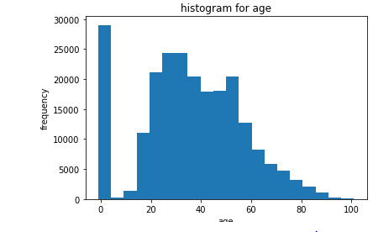
The main result that can be understood by this research is that younger people, age between 20 and 55 years old are mostly involved in the car accidents that are taking place in the United Kingdom.

Slide 6
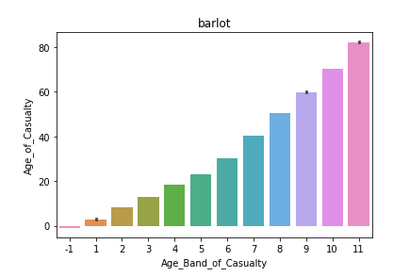
On the other hand, analysing the casualties from these car accidents, we can see that the majority of the casualties are people mostly above 60 years old

Slide 7
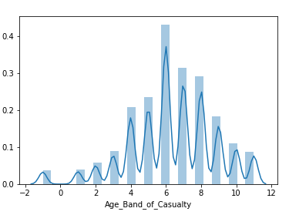
Age band of casualties

